Slide 1

Final Presentation SLAM implementation on AIRSIM SImulation
Ritvik Pandey (INTERN) Sheetal VERNEKAR (INTERN)

Slide 2
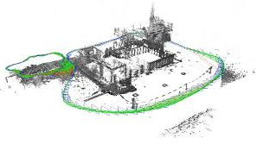
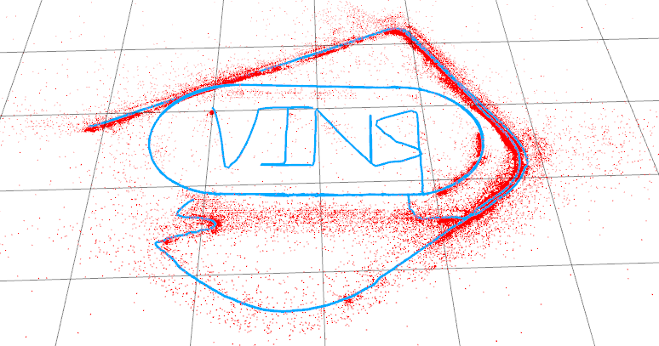
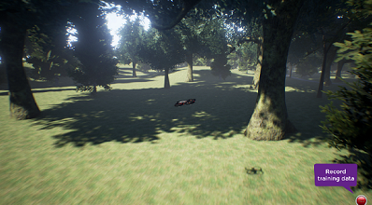
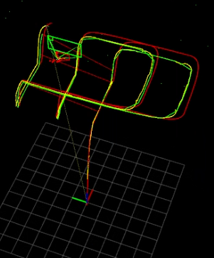
This presentation will cover
Overview of SLAM
Principle, Need
VIO
Filtering based VIO
Optimization based
VINS-Mono
Addressing problems
Overview of steps
Working and formulations
VINS-Mono with AirSim
Working and formulations
Result and Error
Evaluation
Error statestics
To present the general picture of VINS-Mono and its working with AirSim

Slide 3
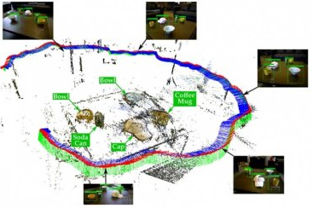
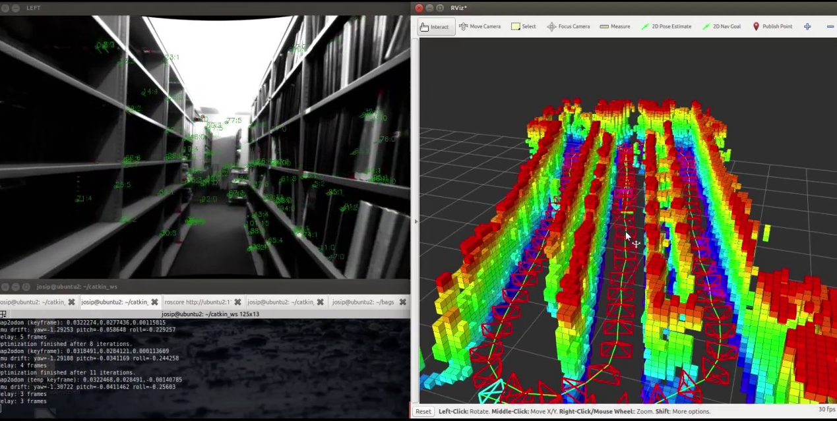
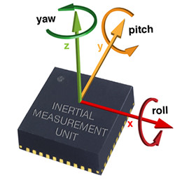
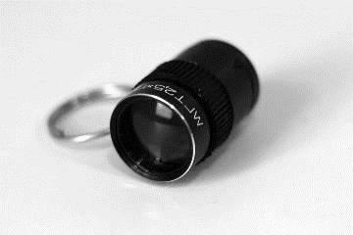
Overview of slam and vi-slam
Camera IMU
Building a real-time map using
Visual data( Camera-mono, stereo)
Inertial data( IMU)
what is the robot's current
Location
Orientation
Construct plan to localize the robot
real-time motion planning

Slide 4
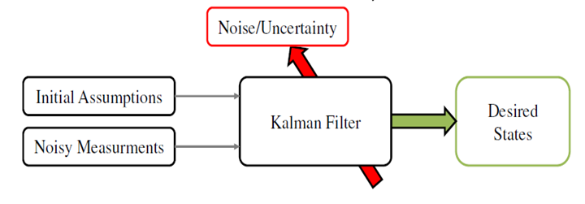
VIO TECHNIQUES
Filtering based
Optimization based
* Inertial data * Visual data
* Dynamic model * Measurement model
(prior distribution)
Faster and computationally cheap
Has larger error and memory consumption
Fail to recover from lost state
Ex-EKF
* Feature extraction * Cost function
* Reprojection error * Optimization
Inertial measurement is treated as prior
reduction of error through re linearization
Computationally intensive (high cost)
Less error and memory requirement
May or may not recover lost state
Prediction step
Updating step
Mapping
Tracking

Slide 5
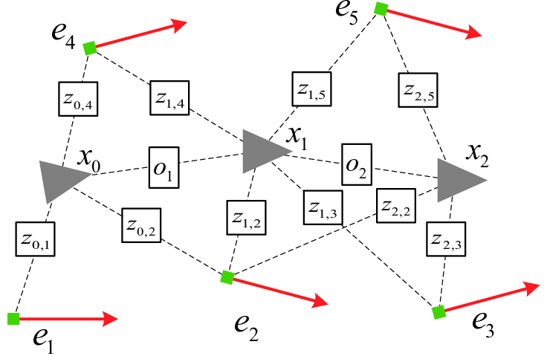
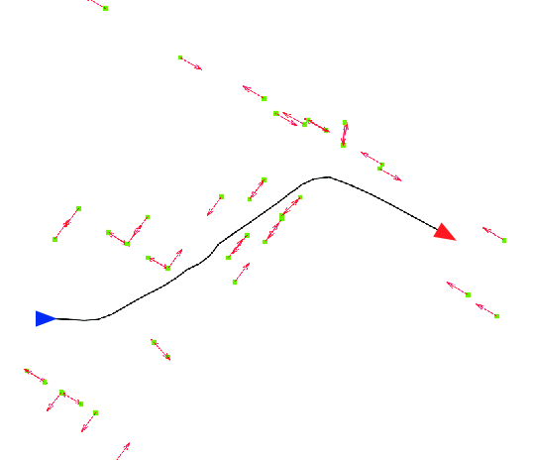
Graph based slam
Benefits
Metric scale with observable roll and pitch angles.
Integration of IMU measurements.
Minimum sensor setup VINS estimators
cannot start from a stationary state
Nonlinear
Calibration
Results long term drifts.
Challenges
Graph-based SLAM the problem is decoupled in two tasks:
Graph construction
probability distribution over the robot poses and detected features
Factor graph
2. Graph optimization
Maximum posterior optimization using Gaussian approximation

Slide 6
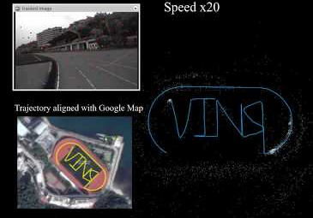
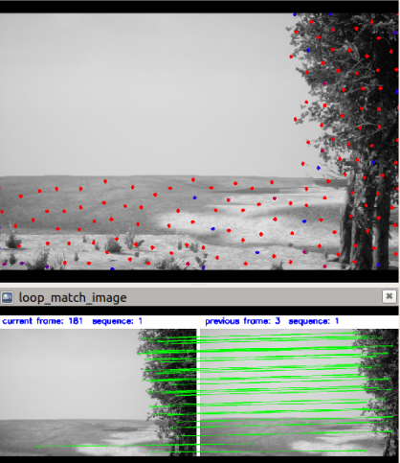
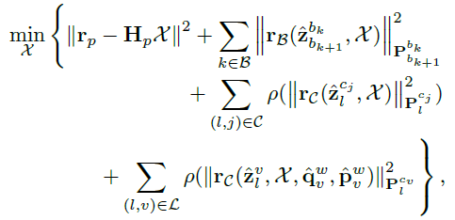
VINS-Mono: Introduction
Tightly-coupled - both visual features and IMU contribute equally to error optimization
Non-linear: The final optimization problem is of order 2
​
Optimization based: The estimated state prediction is done using reiterations of previous data to reach a minimum
possible error and hence optimizing for it.​
​
​
Infact, it has various modules which individually optimize their​
own errors and thus, multiple optimizations are running parallelly. ​​
Optimized cost function
5

Slide 7
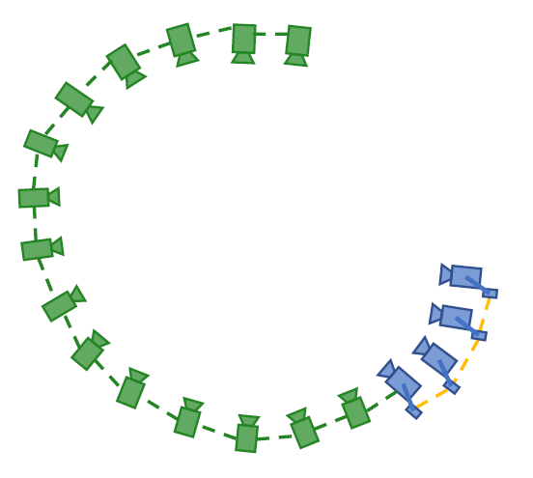
VINS-Mono: Introduction
State of the art tightly coupled non-linear optimization based SLAM
Local odometry
What is happening locally
Optimizing for local odometry errors
Relation with previous few frames and using intermediate IMU data
Global odometry
What is global picture
Taking previously accumulated errors in account
Relation with frames acquired long time back and visiting same point
SLIDING WINDOW
GLOBAL POSE GRAPH
As new frames arrive, we push older keyframes to pose graph

Slide 8
Key modules and PIpeline
Images
IMU
Extracts key features from images and pre-integrates IMU for further processes
Pre-processing
Initialization
Prepares an initial estimate of scale and IMU bias
Gets an estimate of approximate time delay between IMU and image capture
Temporal calibration
Extracts features from recent data to get local motion estimate
Vins Estimator
Aligns and makes connections of old local data to previous global path
Pose Graph
Relocalization and
Pose-graph optimization
Performs drift correction in local as well as global path when a location is re-visited

Slide 9
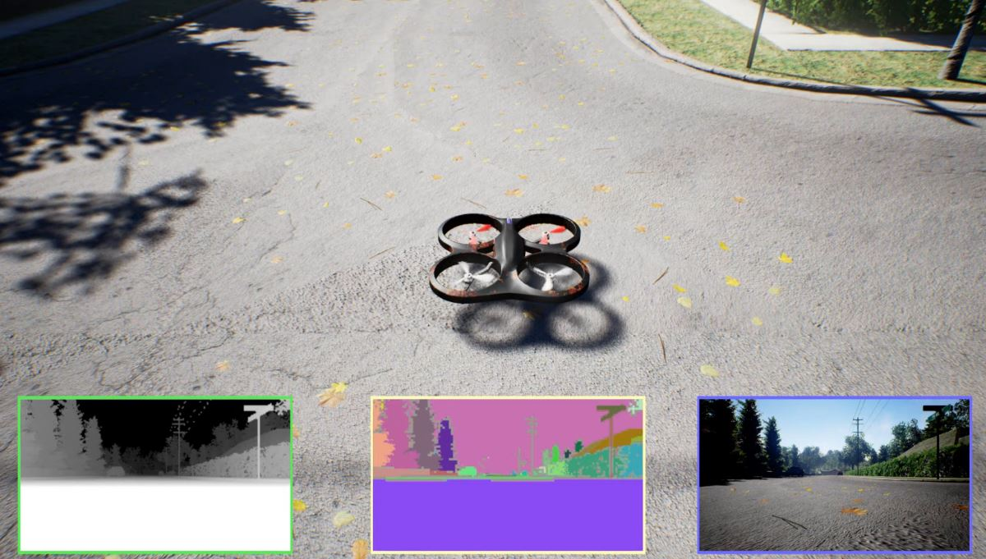
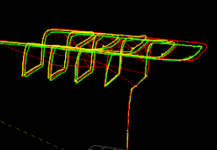
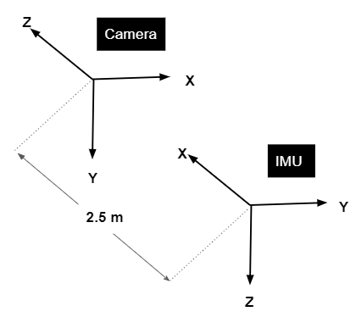
Integration with airsim simulation
AirSim Simulation
VINS-Mono estimate
Ground truth data
Images
Global Position Estimate
IMU
Pre-processing
IMU with errors
Initialization
Temporal calibration
Camera feed
Vins Estimator
Pose Graph
Relocalization and
Pose-graph optimization
Local Position Estimate
Intrinsic and Extrinsic calibrated values between camera and IMU along with initial bias estimates

Slide 10
Demonstration video

Slide 11
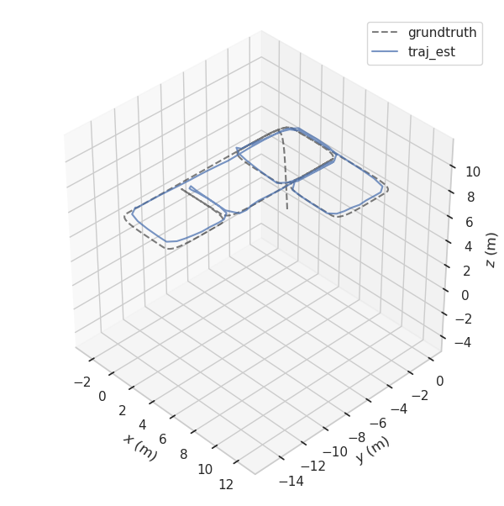
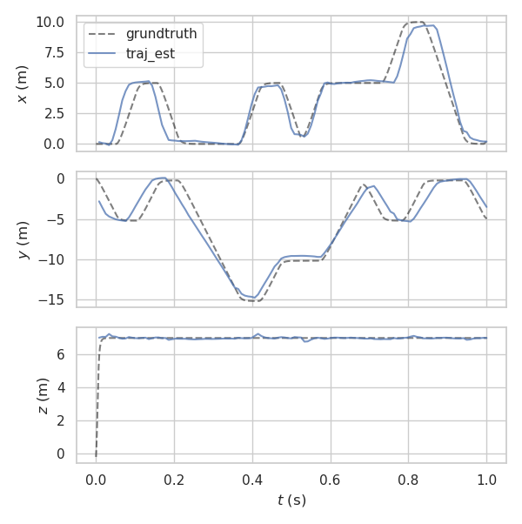
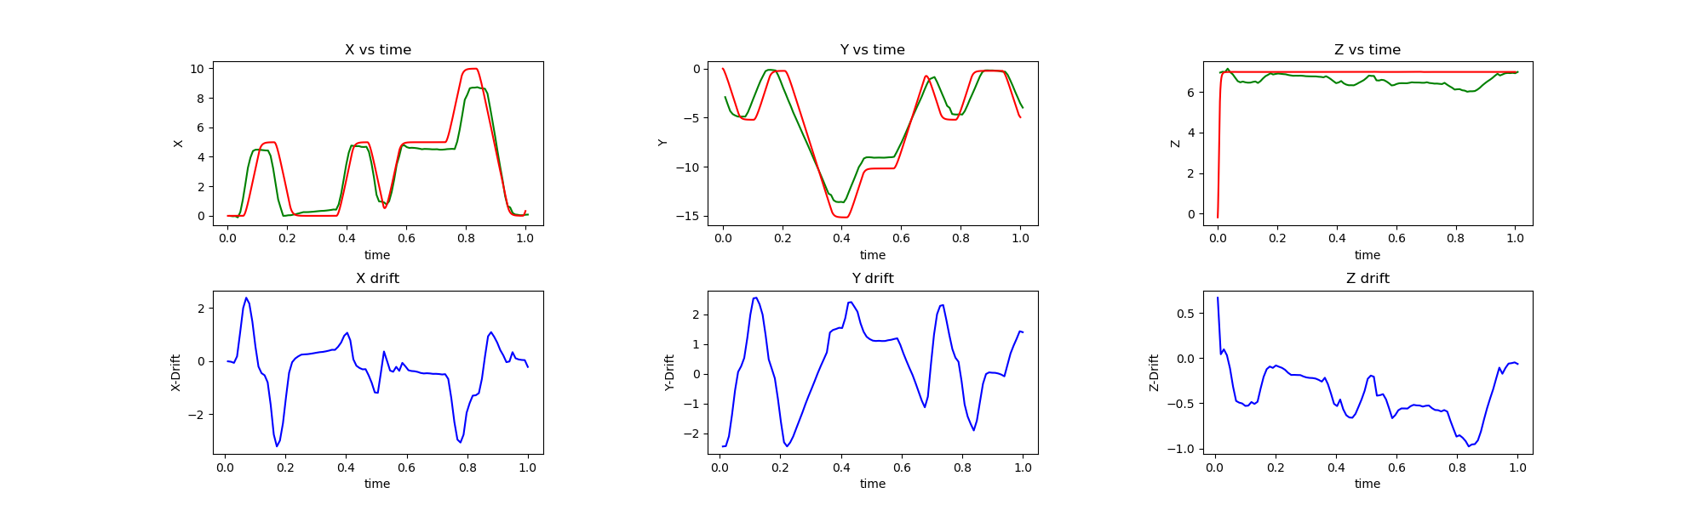
Motion and translation error plots

Slide 12
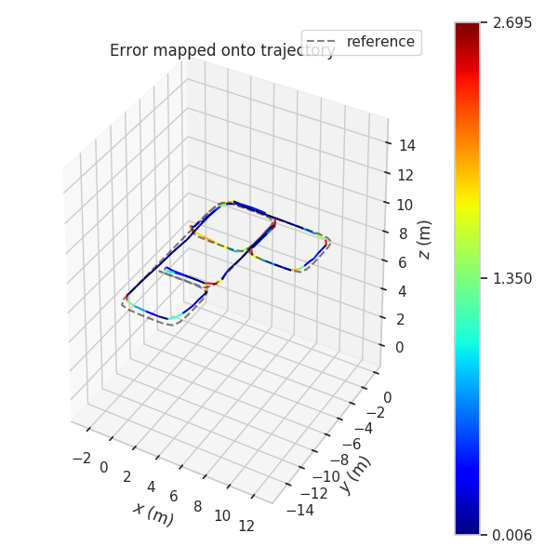
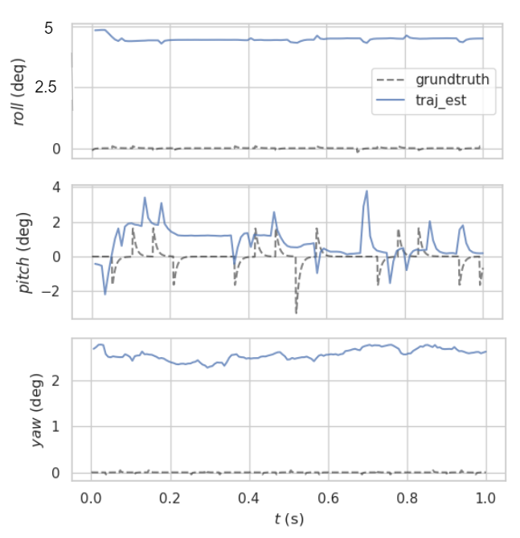
Motion and rotational error plots
Absolute Euler Error plots
Relative Error map

Slide 13
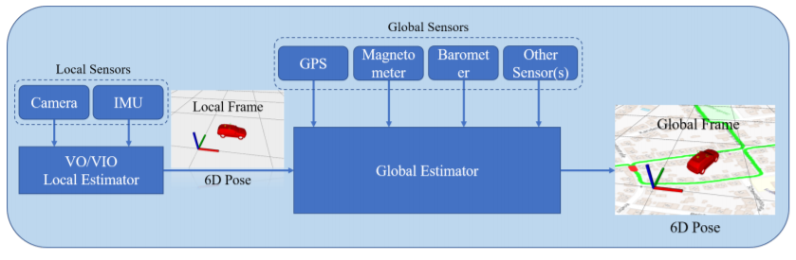
NEXT STEPS
Improve the optimization solver to reduce drifts
Better initialization for IMU parameters
Augment with terrain or map database
Extend to multiple sensors such as Radar, LiDAR
Towards a generic sensor fusion framework

Slide 14
Thankyou

Slide 15
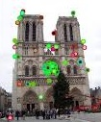
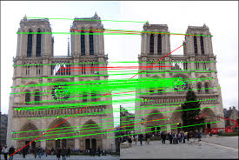
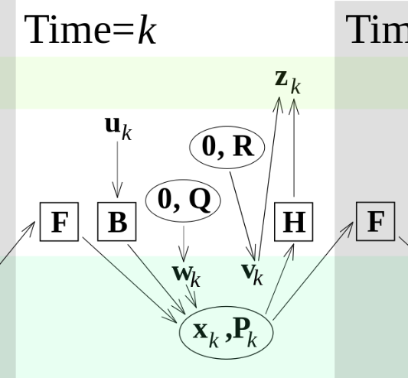
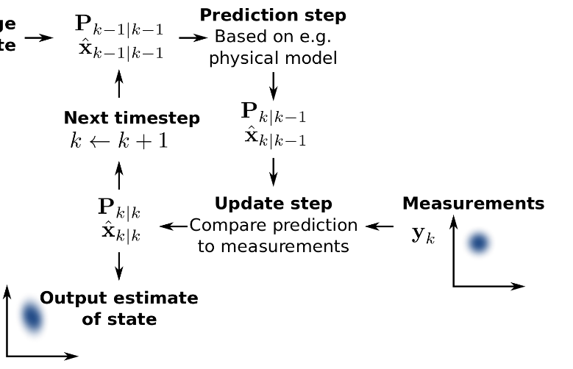
Filtering Based techniques: Overview
Feature Extraction and Tracking
Keypoints and Descriptor
Uses camera feed
- SIFT, SURF : Binacular-Vision SLAM
- Harris Detector: Mono-SLAM
- ORB: ORB-SLAM
Dynamic Observational Model
Control and State estimation using filtering pipeline
Uses IMU data
Extended Kalman Filter for non-linear problems
Two components of filtering based techniques

Slide 16
Feature Extraction and Tracking
Feature Extraction
Keypoints (corner, change in first/second order derivative at a point, local maxima/minima)
The value at which keypoint selected is its descriptor
Feature Tracking
Descriptors are matched with keypoints from other images and warping matrix is calculated.
SIFT, SURF : Binacular-Vision SLAM
Harris Detector: Mono-SLAM
ORB: ORB-SLAM
VINS uses BRIEF descriptor and KLT sparse optical tracker

Slide 17
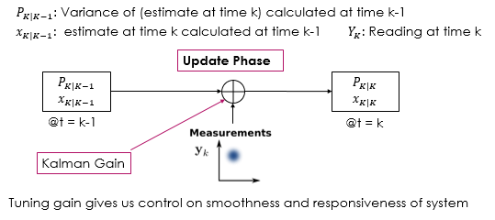
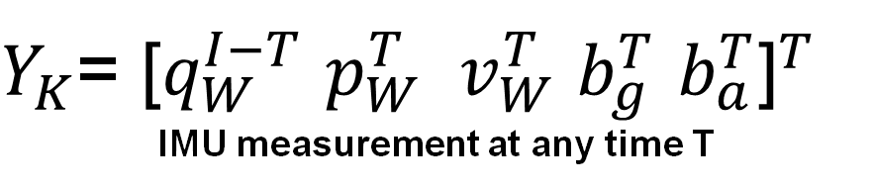
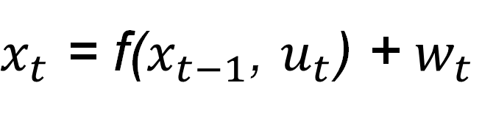
Filtering: Dynamic observational model
$x_{t}$ = f($x_{t−1}$, $u_{t}$) + $w_{t}$
Usage
Serves as both control and state estimation of the filtering pipeline
Need
In real world, data arrives with lag so an estimation is need of state of drone at each moment in time
$Y_{K}$= ${\text{[}q_{W}^{I−T} p_{W}^{T} v_{W}^{T} b_{g}^{T} b_{a}^{T}\text{]}}^{T}$
IMU measurement at any time T
Updating the new estimate and variance

Slide 18

Filtering: Dynamic observational model
$x_{t}$ = f($x_{t−1}$, $u_{t}$) + $w_{t}$
Usage
Serves as both control and state estimation of the filtering pipeline
Need
In real world, data arrives with lag so an estimation is need of state of drone at each moment in time
Prediction Phase
$Y_{K}$= ${\text{[}q_{W}^{I−T} p_{W}^{T} v_{W}^{T} b_{g}^{T} b_{a}^{T}\text{]}}^{T}$
IMU measurement at any time T
Prediction of state using previous state and control vector with noise

Slide 19
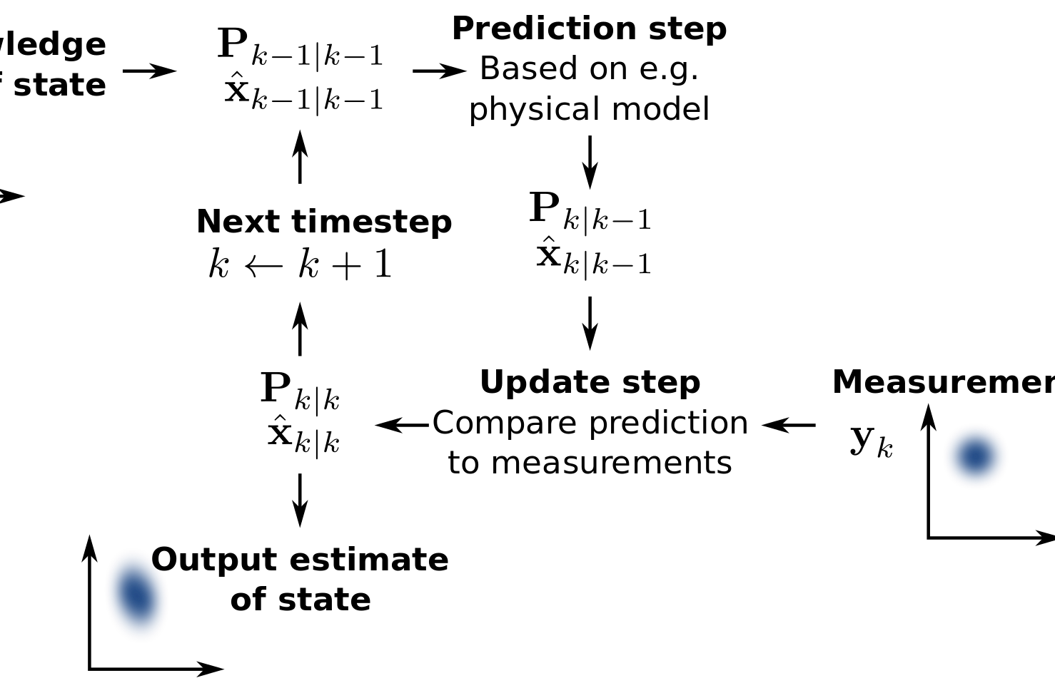
Filtering: Dynamic observational model
$x_{t}$ = f($x_{t−1}$, $u_{t}$) + $w_{t}$
Usage
Serves as both control and state estimation of the filtering pipeline
Need
In real world, data arrives with lag so an estimation is need of state of drone at each moment in time
$Y_{K}$= ${\text{[}q_{W}^{I−T} p_{W}^{T} v_{W}^{T} b_{g}^{T} b_{a}^{T}\text{]}}^{T}$
IMU measurement at any time T
Prediction of state using previous state and control vector with noise

Slide 20
VINS-Mono: Pre-Processing
State of the art tightly coupled non-linear optimization based SLAM
Feature detection and Tracking
Key-point selection
Camera
Key-point Tracking
IMU data
IMU Pre-integration
IMU bias estimation
and parameterization
VISION PRE-PROCESSING
Feature Detection: BRIEF descriptor (rotational in-variant)
Feature Tracking: KLT sparse optical flow
Keypoint Outlier rejection: RANSAC + uniform special distance between keypoints
Keyframe selection: average parallax from previous keyframe more than threshold. Any image not a keyframe is thrown and only IMU data kept.

Slide 21
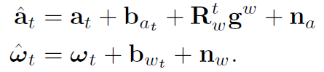
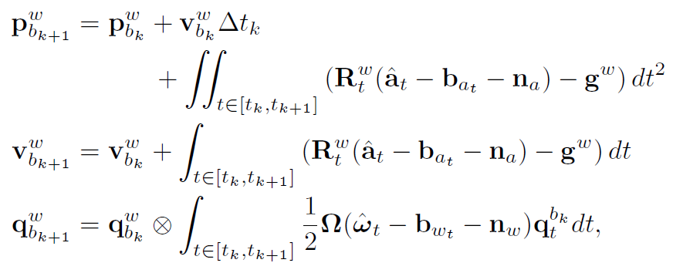
VINS-Mono: Pre-Processing
IMU Pre-Integration
IMU PRE-INTEGRATION
Why is it required
What happens in this process
Mathematical Formulation
Accelerometer and Gyroscopic measurements from IMU
Translation vector, Velocity vector and Rotation vector from body frame to world frame

Slide 22
VINS-Mono: Pre-Processing
IMU Pre-Integration
Why pre-integration?
NOTE: All these vectors use reference from previous measurement $b_{K}$ so if we find that an old estimation was slightly wrong, we need to re-propogate back to all those steps if same formulae are used.
Accelerometer and Gyroscopic measurements from IMU
Translation vector, Velocity vector and Rotation vector from body frame to world frame

Slide 23
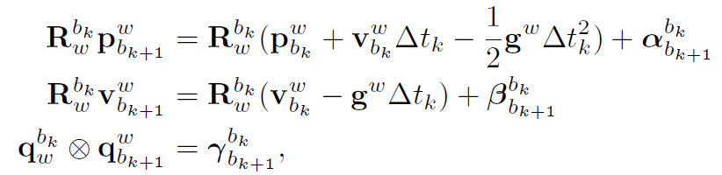
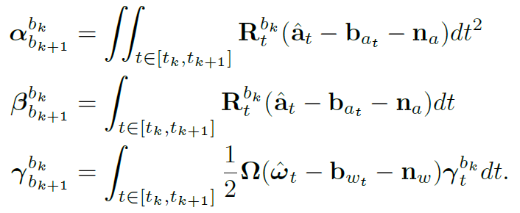
VINS-Mono: Pre-Processing
IMU Pre-Integration
New vector estimates which do not directly use previous measurements
Changing from world to body frame:
Here, α (alpha), β (beta), γ (gamma) only depend on bias and not on any previous state
So we need not to re-propogate whenever our bias estimate “b” changes

Slide 24
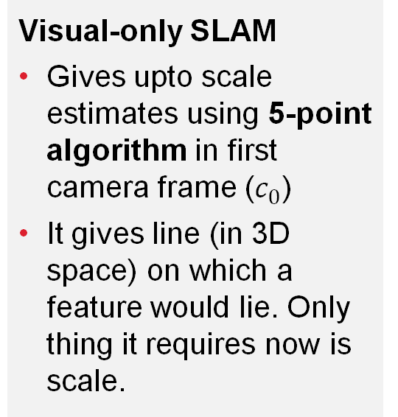
VINS-Mono: INITIALIZATION initial estimate of position, orientation, velocity, scale, bias
Structure from Motion (SfM)
Visual-Inertial Alignment
Final optimizing step for scale
Visual-only SLAM
Gives upto scale estimates using 5-point algorithm in first camera frame ($c_{0}$)
It gives line (in 3D space) on which a feature would lie. Only thing it requires now is scale.
Using visual data for bias correction
Optimizes rotational error between 2 consecutive frames to give gyroscopic bias estimation (gives gamma)
Alpha, beta are written in terms of scale
Optimizing for scale to minimize error in measurement
We have gamma and alpha, beta are written in terms of scale. Now the error between current and previous state (in terms of scale) is minimized to give us scale measurement
Finally, position, velocity are scaled and provided to core-VIO algorithm for successive update

Slide 25

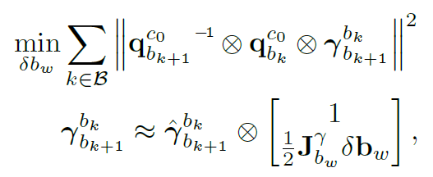
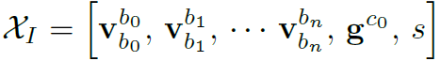
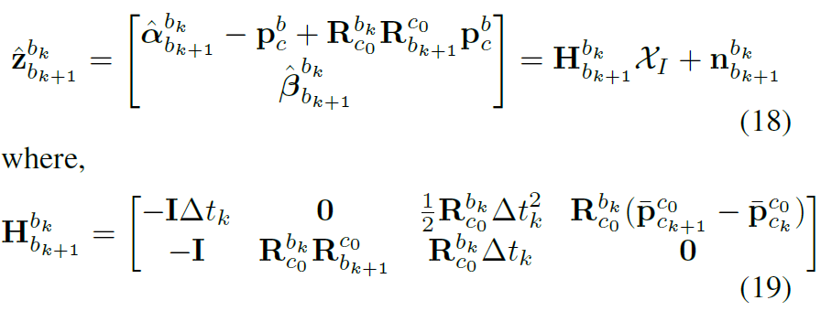
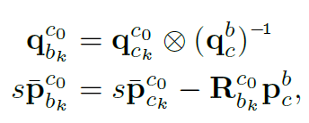
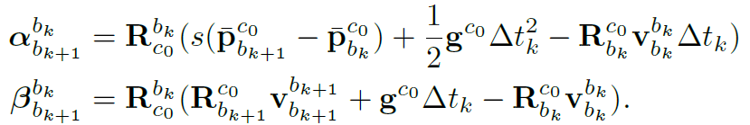
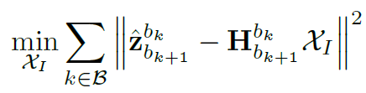
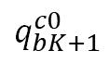
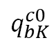
VINS-Mono: INITIALIZATION initial estimate of position, orientation, velocity, scale, bias
OPTIMIZATION 1
Gives gamma
Error optimization cost for bias estimation
From IMU pre-integration
$$q_{bK}^{c0}$$
$$q_{bK+1}^{c0}$$
Now we have good estimate of gamma and alpha, beta are written in terms of scale. The reading (z) at any given frame can be written as
From SfM
Equation governing translation and rotation in camera frame
Alpha/Beta in terms of scale and IMU readings
Gives Scale
OPTIMIZATION 2

Slide 26

VINS-Mono: Core VIO Algorithm
Using previous state and new visual and IMU data to update the state estimate
This module works only on Sliding Window part
Priori
Sliding Window
marginalized
If second latest image not a keyframe: its image data is thrown and only IMU kept. No frame marginalized
If second latest image is a keyframe: oldest frame in sliding window marginalized (converted to priori)
AIM: Keep latest and spatially separated keyframes in the window
Failure Detection and Bundle Adjustment

Slide 27
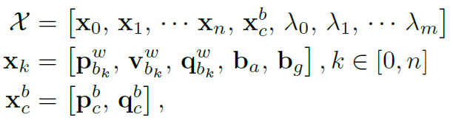
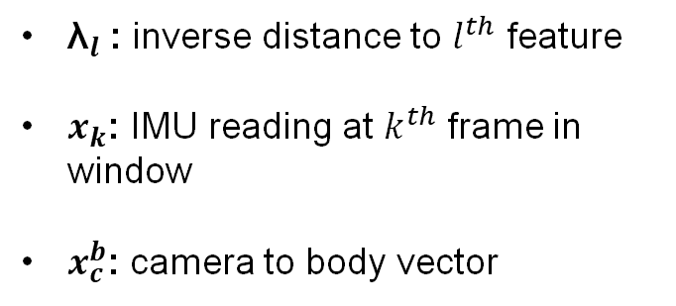
VINS-Mono: Core VIO Algorithm
Using previous state and new visual and IMU data to update the state estimate
This module works only on Sliding Window part
Priori
Sliding Window
State vector in sliding window can be represented as:
${\text{λ}}_{l}$: inverse distance to $l^{th}$ feature
$x_{k}$: IMU reading at $k^{th}$ frame in window
$x_{c}^{b}$: camera to body vector

Slide 28
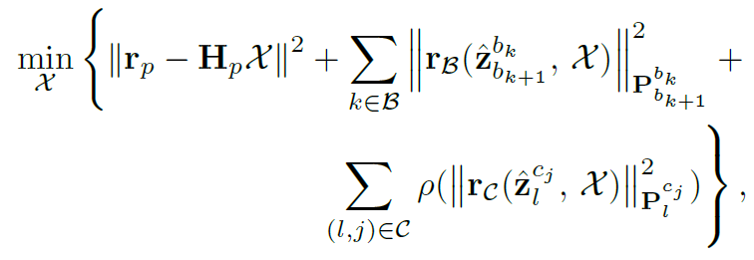
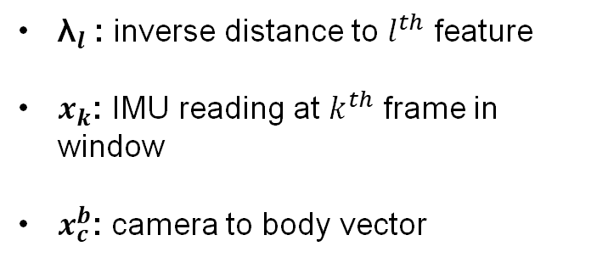
VINS-Mono: Core VIO Algorithm
Using previous state and new visual and IMU data to update the state estimate
Optimization function to be satisfied at each timestep
IMU residual error
Visual measurement residual error
Error due to prior information
State vector in sliding window can be represented as:
${\text{λ}}_{l}$: inverse distance to $l^{th}$ feature
$x_{k}$: IMU reading at $k^{th}$ frame in window
$x_{c}^{b}$: camera to body vector

Slide 29
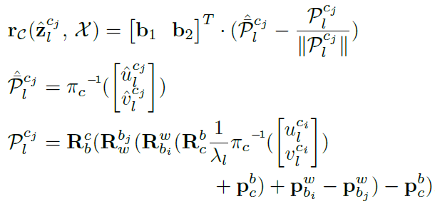


VINS-Mono: Core VIO Algorithm
Using previous state and new visual and IMU data to update the state estimate
IMU residual error
Visual Measurement residual error
Observed
Change in IMU states and bias estimates from previous frame to this frame by pre-integration step
Expected
What does it all mean?
It is just the scaled camera reprojection error of a feature
Error = Scale*(expected reprojection – true)
P : unit vector along reprojection

Slide 30

VINS-Mono: Relocalization v/s Pose Graph
Occurs at loop closure
Every effort is made to minimize error but still some drift occurs. When we visit a location again, our past knowledge and current position can help us correct for those drifts. Correcting those drifts in sliding window is Relocalization and thereby adjusting previous data according to it is Global pose graph optimization

Slide 31

VINS-Mono: Relocalization
Relocalization has 2 steps:
Loop detection: DBoW2 (Database Bag of Words representation of image features indexed for fast retrieval)
Optimization
$l^{th}$ feature observed previously in $v^{th}$ frame
Hence apart from usual cost function for sliding window, we now have a term which constraints us with loop connections to give us new estimated state and thus minimizing the overall drift.

Slide 32


VINS-Mono: Global Pose Graph Optimizatio
As we have already relocalized the sliding window, the pose graph looks like image 5
4-Dof pose graph optimization:
Done according to sequential and loop closure edges residual error
Pose Graph
Sequential edges
Loop edges

Slide 33

VINS-Mono: Working
Every /Scene data goes to /feature_tracker (pre-processing) and /pose_graph (detect loop closure)
If any matched points from previous poses, /pose_graph gives it to /vins_estimator (VIO-core) to optimize for it
All marginalized keyframes are saved in /pose_graph
Currently, we have set VINS to receive IMU data from mavros (can be made to take from airsim too)
Feature tracker tells /vins_estimator to restart if it looses track by a separate channel /feature_tracker/restart

Slide 34







VINS-Mono: Temporal Caliberation
IMU and camera measurement don’t arrive at the same time, hence an estimate of time delay ($t_{d}$) is required
Expected location of feature considering time delay
New state function
Using same optimization cost function as before but with a newer state function

Slide 35
Frequency TEST
Range of motion
Tweaks made:
ROS wrapper publishing rate and delay duration changed
Disabled all checks for lidar and other sensors
Shapes tested:
Bigger rectangle (~200m perimeter) with no loop closure
Random directional motions 100-200m traversed.
Deviations become significant as path length is increased beyond that without loop closure
Could not test path lengths upto a 1-2 km as drone moves out of environment and looses all features.
IMU topic frequency | Image topic frequency | VINS output frequency
4 hz | 4 hz | 4 hz
20 hz | 4 hz | 10 hz
50 hz | 4 hz | 10 hz
20 hz | 15 hz | 10 hz

Slide 36

Code Architecture (VINS)

Slide 37

Code Architecture (VINS)

Slide 38

Code Architecture (VINS)

Slide 39

Code Architecture (VINS)

Slide 40

Working Pipeline
VINS-MONO
Notes:
Drone movements in Airsim are controlled by a python module
Another python publisher is used to publish ground truth
Airsim_ros_wrapper publishes image and IMU to VINS-Mono
VIO, pose graph and ground truth are gathered by RVIZ

Slide 41

LAST week RESULTS
Red = Pose graph path (global odometry)
Green = VIO path (local odometry)
Ground truth not published
Camera calibration from euroc dataset
Crashes frequently
Wrong Scales (312 vs 32)
Odometry does not have given geometry
Notes:
Drone movements in Airsim are controlled by a python module
Another python publisher is used to publish ground truth
Airsim_ros_wrapper publishes image and IMU to VINS-Mono
VIO, pose graph and ground truth are gathered by RVIZ

Slide 42

Calibration Matrix
Previous approach:
Unstable initialization
Deviation from co-ordinate axis in terms of translation
Notes:
Drone movements in Airsim are controlled by a python module
Another python publisher is used to publish ground truth
Airsim_ros_wrapper publishes image and IMU to VINS-Mono
VIO, pose graph and ground truth are gathered by RVIZ

Slide 43


Calibration Matrix
Rechecked using camera info API,
Camera co-ordinates are 0.5,0,0 wrt the body
Camera orientation is also 0,0,0
No information regarding IMU location and orientation given
Current approach:
Much stable initialization
Co-ordinate shift still and changing translation matrix does not help
Notes:
Drone movements in Airsim are controlled by a python module
Another python publisher is used to publish ground truth
Airsim_ros_wrapper publishes image and IMU to VINS-Mono
VIO, pose graph and ground truth are gathered by RVIZ

